Slide 1

Notes:
[SHOW VIDEO CLIP]
[BRIEF INTRO]
The Nativity Story – Zechariah (an old priest) in the Temple
An angel of the Lord speaks
This Advent season we’re in a series on John the Baptist—the prophet who prepared the way for Jesus’ coming. Through his message of repentance, grace, and renewal, we’re looking at what it means to prepare our hearts for Christ’s arrival and to live as witnesses of his light. Each week we’re being invited into the hope, peace, joy, and love of Advent, leading to the celebration of Christ’s birth and the call to let his life increase in us.
Last week we began our series with an introduction to the message and ministry of John the Baptist, and with an invitation to prepare our hearts for the coming of the Lord as we journey through Advent to Christmas. In this second message… [NEXT SLIDE]

Slide 2

Notes:
God is Gracious. We’re going back to the beginning of John’s story—all the way back to how God supernaturally intervened in the life of his parents, bringing about his birth. And in keeping with the biblical story, every significant turning point or major event in the narrative of God’s redemptive work in history, happens through an act of God’s grace. And as we will see this morning, so it is with our own lives.
Let’s begin now with our main Scripture reading for today. Please open your Bible to the Gospel of Luke… [NEXT SLIDE]

Slide 3

Notes:
[INVITE PEOPLE TO STAND & READ LUKE 1:5-25 NIV]
This is the word of the Lord. Thanks be to God. You may be seated.
What ways have you experienced God’s grace in your life?
My own life: (1) wedding ceremony; (2) unexpected financial gifts; (3) unanswered prayers; (4) horrible things that happened—God brought good out of serious trials and hardships
What do we mean by “grace” and that God is gracious? In his book, Prepare the Way for the Lord, Adam Hamilton writes this… [NEXT SLIDE]

Slide 4
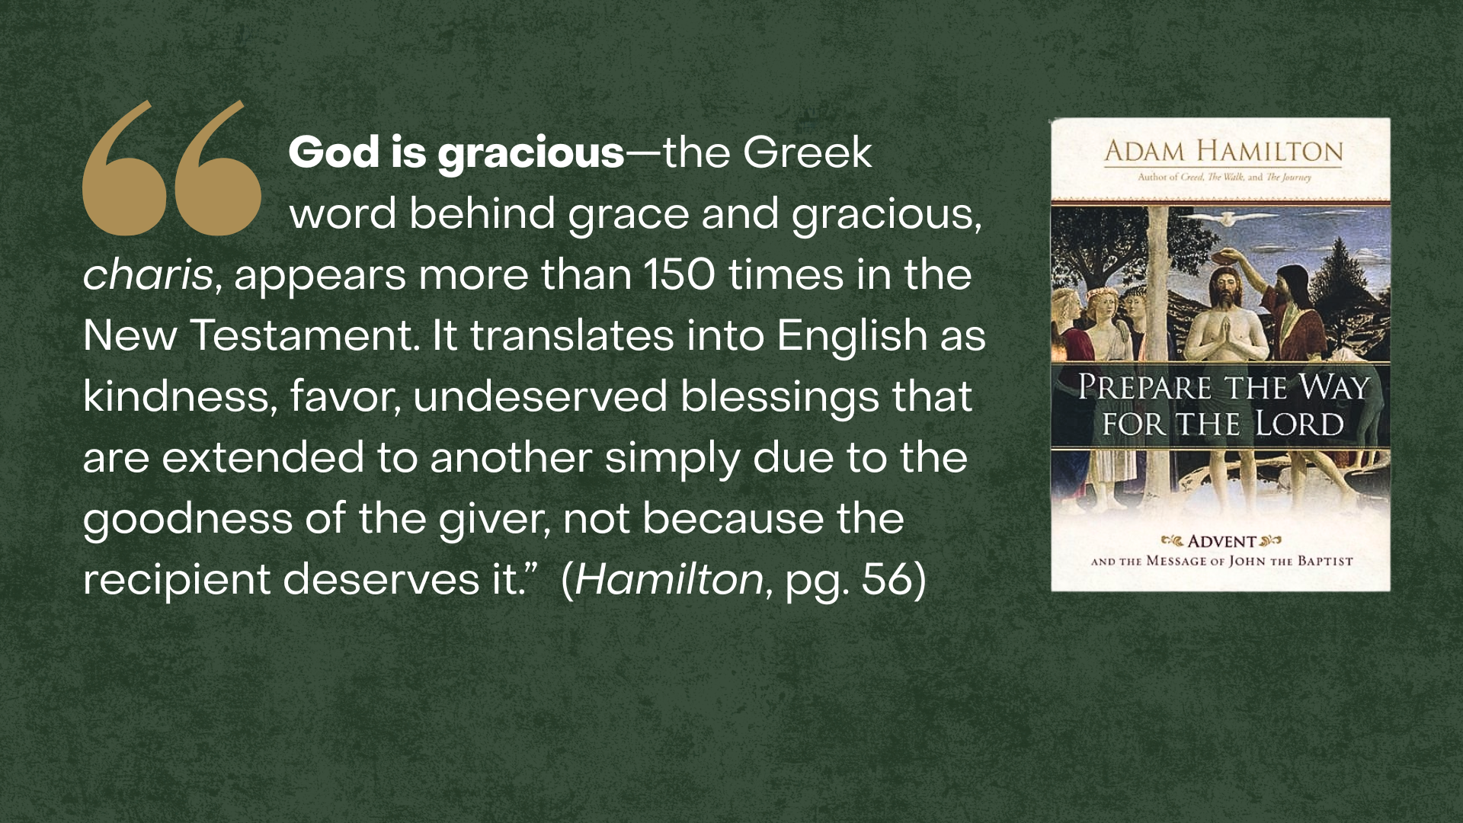
Notes:
[READ QUOTE & COMMENT]
The Greek word charis—which is translated as "grace" in the New Testament—was a common term in the broader Greco-Roman world, but it was not considered a virtue. It typically referred to a system of patronage and reciprocal obligations: Wealthy patrons provided gifts or assistance (charis) to those of a lesser status (clients). While the initial gift was free, it came with a strong social expectation of gratitude and a sense of obligation on the recipient's part.
But the Christian concept of grace fundamentally redefined the term. In Christian theology, grace is the "free and undeserved help that God gives us”—a divine gift that humans cannot earn through their own merit or effort. Remember what the apostle Paul wrote in Ephesians 2:8-9 – “For it is by grace you have been saved, through faith—and this is not from yourselves, it is the gift of God—not by works, so that no one can boast.” And when that grace is given to us by God, our response to him does not come out of a social or religious obligation, instead, it springs up like a joyful child who has been given a gift from a loving parent.
And this is the God who looks like Jesus. He’s a God who surprises us with gifts of his grace, but he’s also a God who is approachable—his grace is available to those in need of it, especially in times of temptation and trial. That is why the author of Hebrews wrote this in Hebrews 4:16 – “Let us then approach God’s throne of grace with confidence, so that we may receive mercy and find grace to help us in our time of need.”
And it goes without saying that Zechariah and Elizabeth were an older couple in a time of need, but they had given up on God answering one of their prayers. In fact, it’s quite possible that they had stopped praying for something that seemed impossible in their old age: their first child. [NEXT SLIDE]

Slide 5
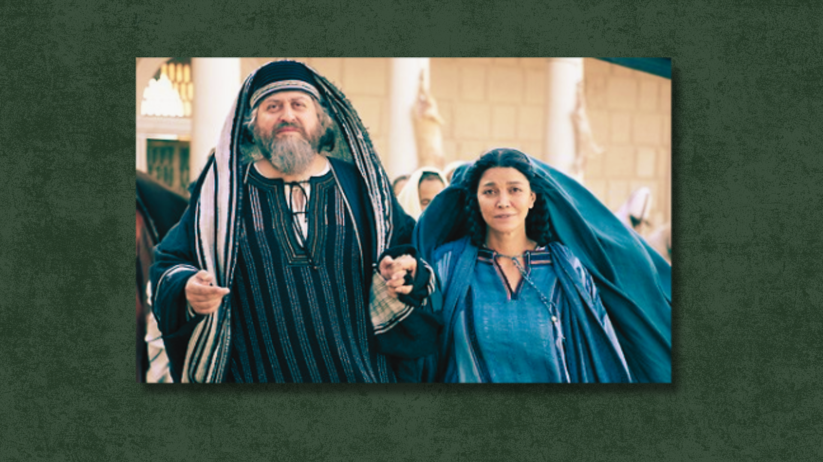
Notes:
Zechariah and Elizabeth had battled infertility for many years, which would have been seen by many at that times as a judgment from God (i.e., God had closed her womb), but they were still steadfast in their faith. Zechariah still faithfully served in the Temple, and Elizabeth was the supportive wife. However, you can keep to the path of righteousness and still become callous to good news and skeptical of God doing the seemingly impossible because of your life experiences. We can all relate to that in some way. Sure, God is gracious. But it can seem at times like that grace is lavishly poured out on others, just not you.
​
Perhaps it’s after years of asking ”Why, Lord?” that Zechariah isn’t at his best and able to joyfully receive the words of the heavenly messenger in the Temple. [NEXT SLIDE]

Slide 6
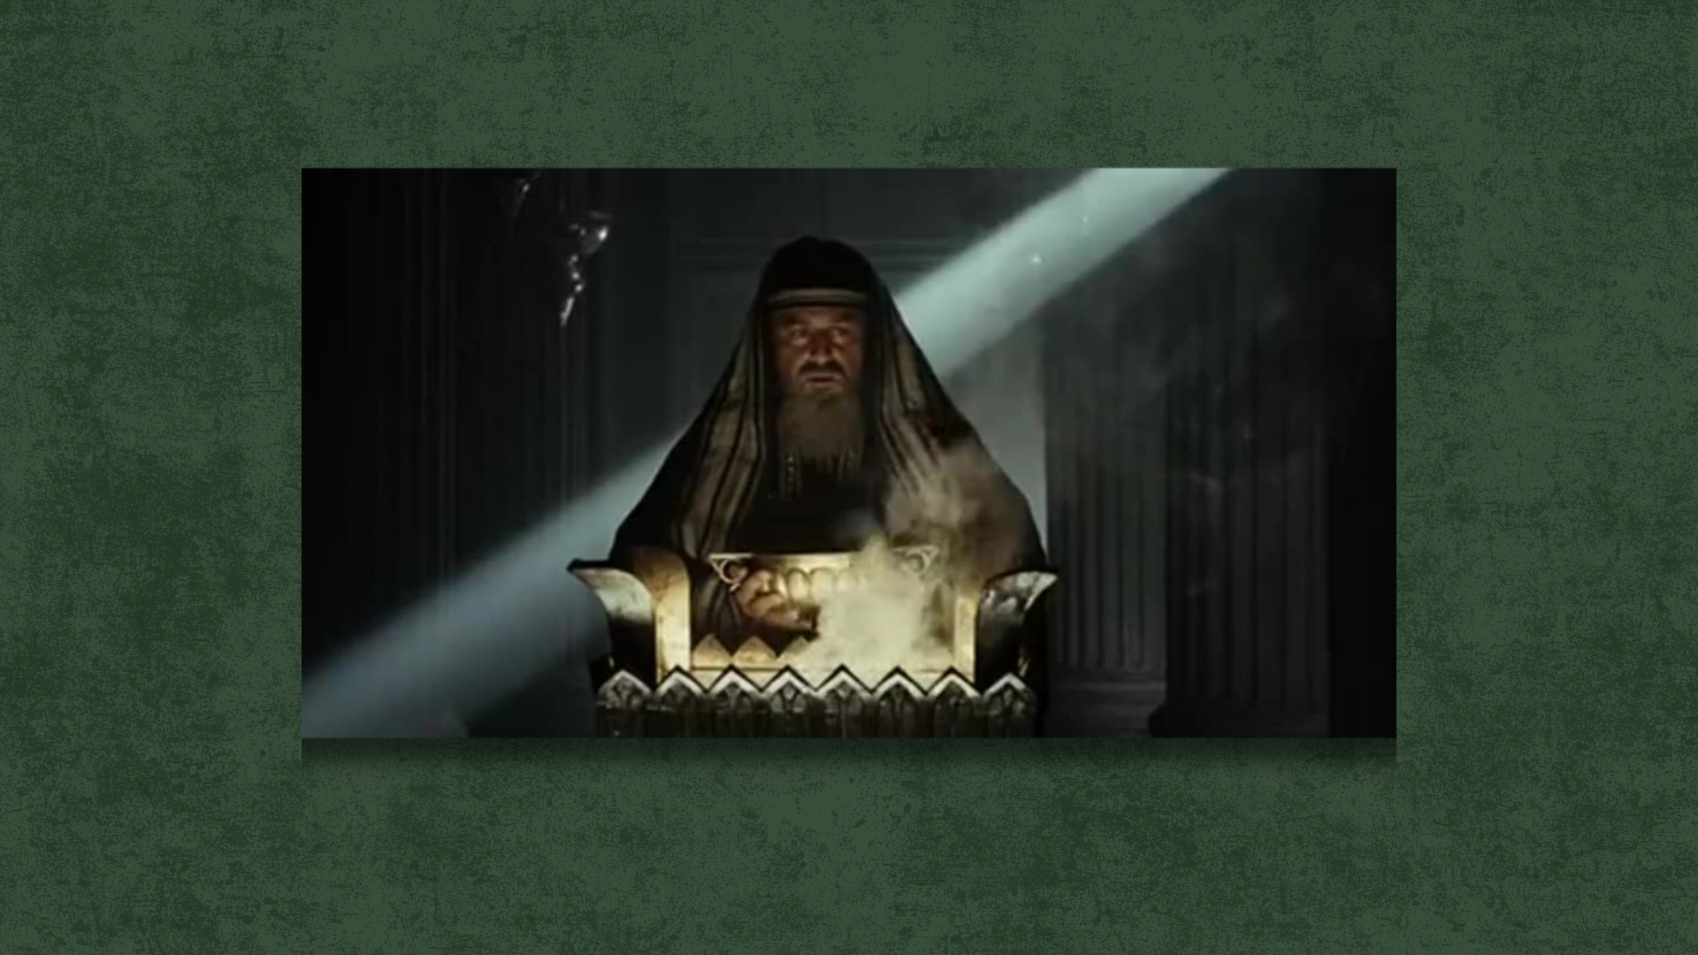
Notes:
Just think about it. As Zechariah is feeding the altar of incense, where the rising smoke represents the prayers of the people to God, the angel Gabriel comes to Zechariah with a promise of good news. But Zechariah can’t fully receive it (it’s too much for him, even though he had prayed for this for years), and he moves into silence for the duration of Elizabeth’s pregnancy. Even she will keep her gift hidden for several months.
Friends, we all understand this: sometimes weariness (even old age) can harden us and prevent us from recognizing and receiving God’s grace in our lives. It’s been a hard journey. We’ve struggled and toiled with something for longer than we can remember. Our grief has scarred and calloused us. And we’re left waiting; trying not to be unbelieving, bitter, or cynical; just clinging to whatever faith we have left. ​
And slowly, but surely, the seed of God’s gracious gift grows inside of you. It becomes harder to ignore or deny. And as you reflect on the love, the mercy, and the grace of God, your heart softens and you begin to experience something you never thought you’d experience again: joy. And God makes a way where there seemed to be no way. Just as he has done so many times before with countless others, the Lord births something new in you.
Let’s see how that plays out for Zechariah and Elizabeth by reading the rest of Luke chapter 1… [NEXT SLIDE]

Slide 7

Notes:
[READ & COMMENT ON PASSAGE]
John (Johanan) – the Lord is gracious
“His name is John” – Zechariah aligns his heart with God’s will and his speech returns
Zechariah’s song: a song that was brewing in his heart can now be released
If you’re taking notes, here are three main takeaways from this message… [NEXT SLIDE]

Slide 8


Slide 9
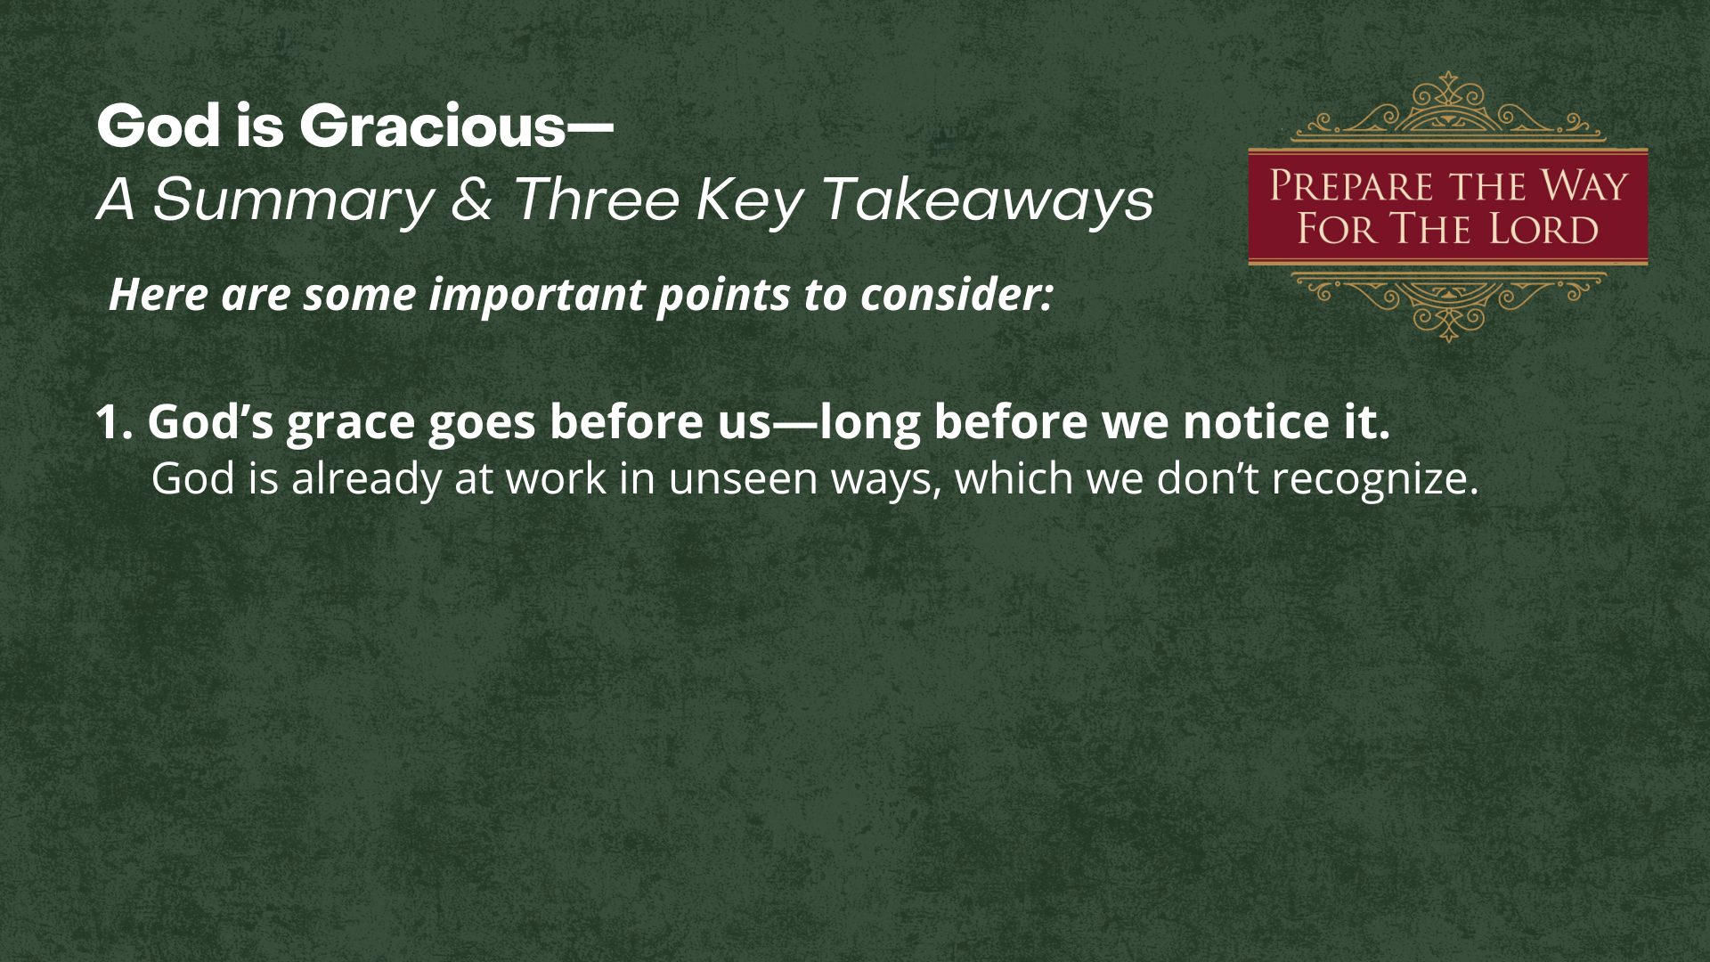

Slide 10
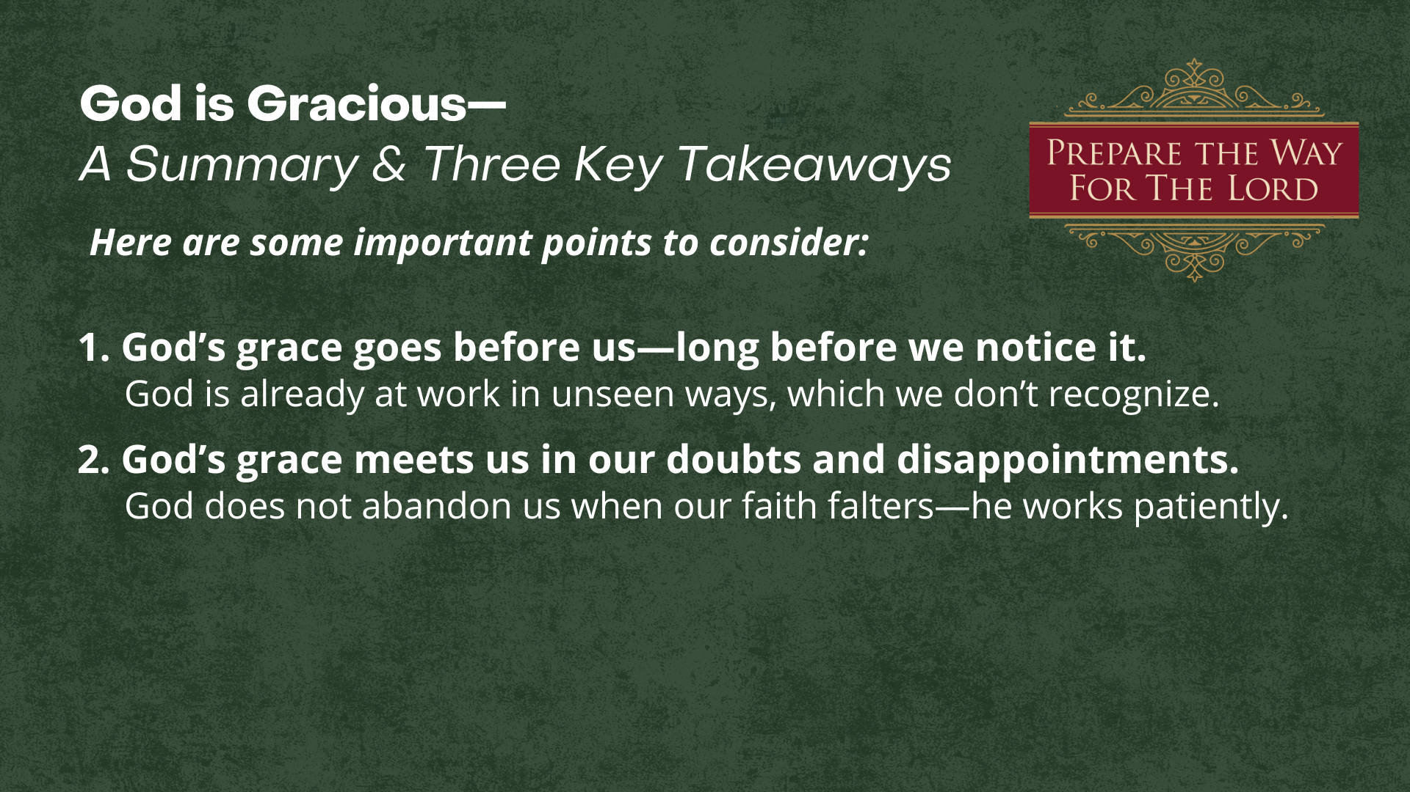

Slide 11
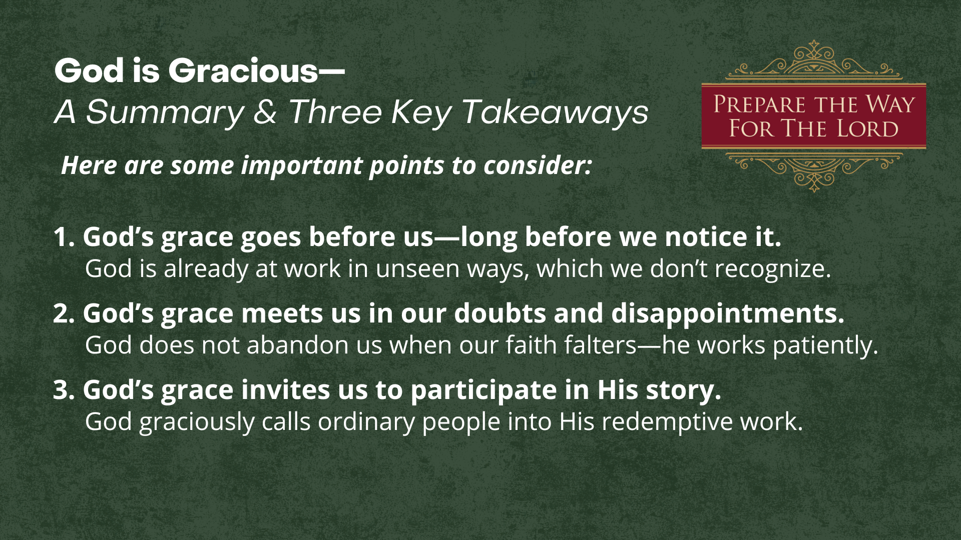
Notes:
[READ TAKEAWAYS & COMMENT BRIEFLY]
1. God’s grace goes before us—long before we notice it.
Like the surprising grace that surrounded Zechariah and Elizabeth, God is already at work in unseen ways, preparing blessings, opportunities, and encouragement we don’t yet recognize.
2. God’s grace meets us in our doubts and disappointments.
Zechariah’s story shows that God does not abandon us when our faith falters. Instead, He works patiently within our uncertainty, turning our silence, waiting, and frustration into a deeper trust.
3. God’s grace invites us to participate in His story.
John’s birth reminds us that grace doesn’t just comfort—it commissions. God graciously calls ordinary people into His redemptive work, giving us a part to play in preparing the way for Christ.
Listen to what the apostle Peter wrote in his epistle… [NEXT SLIDE]

Slide 12
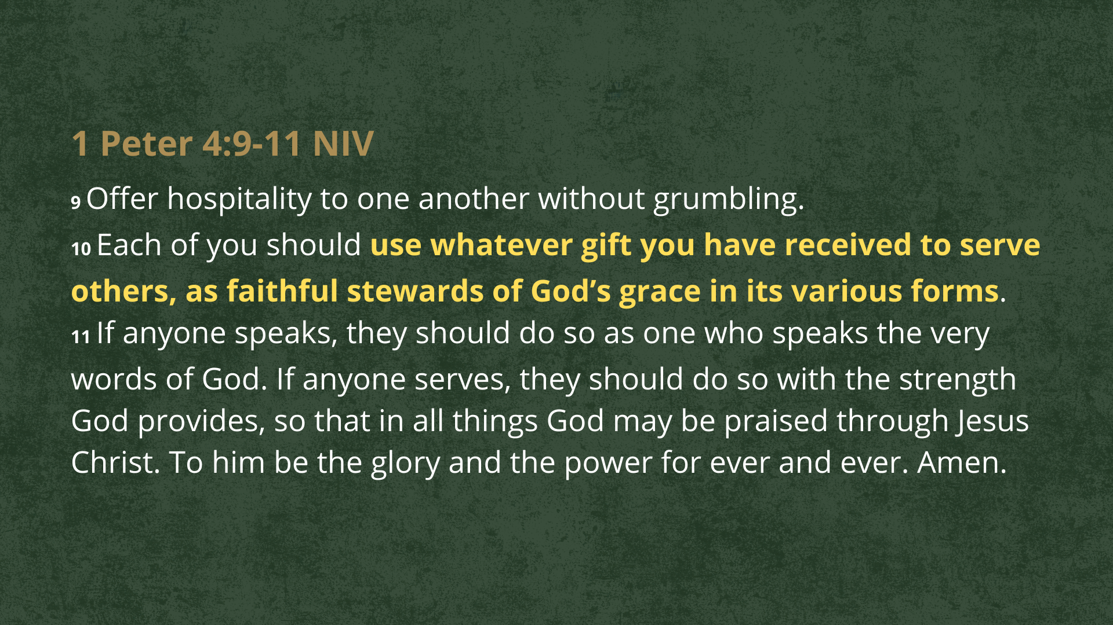
Notes:
[READ PASSAGE & COMMENT]
We can’t give away what we haven’t received ourselves
Therefore, we may need to have our own eyes opened to how gracious God has been to us, so that we can experience the gratitude and the joy that compels us to pass on that same grace to others.
And so, let’s begin there with questions to help us reflect and respond to this message… [NEXT SLIDE]

Slide 13
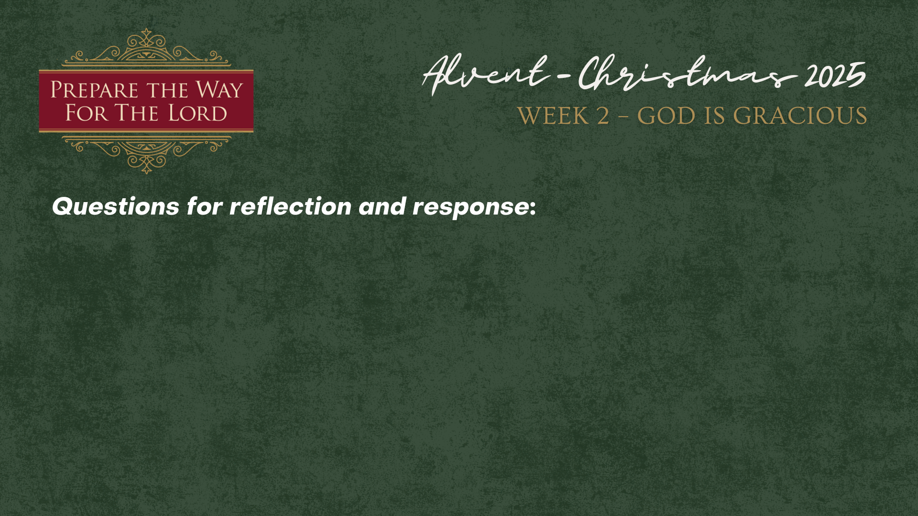

Slide 14
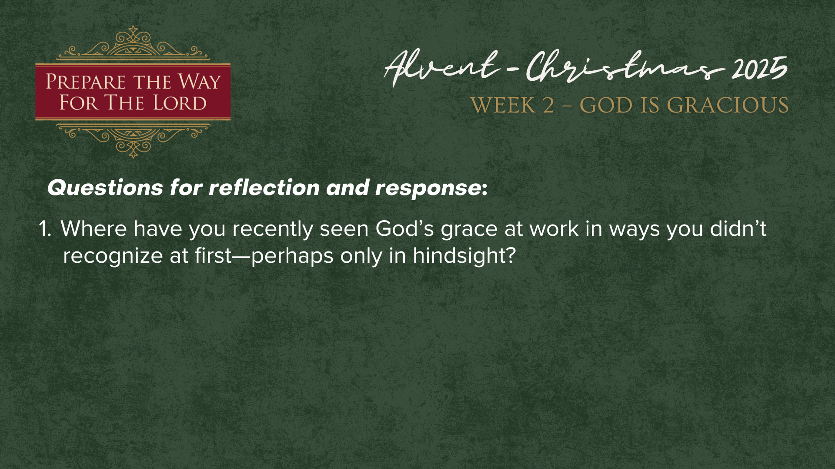

Slide 15
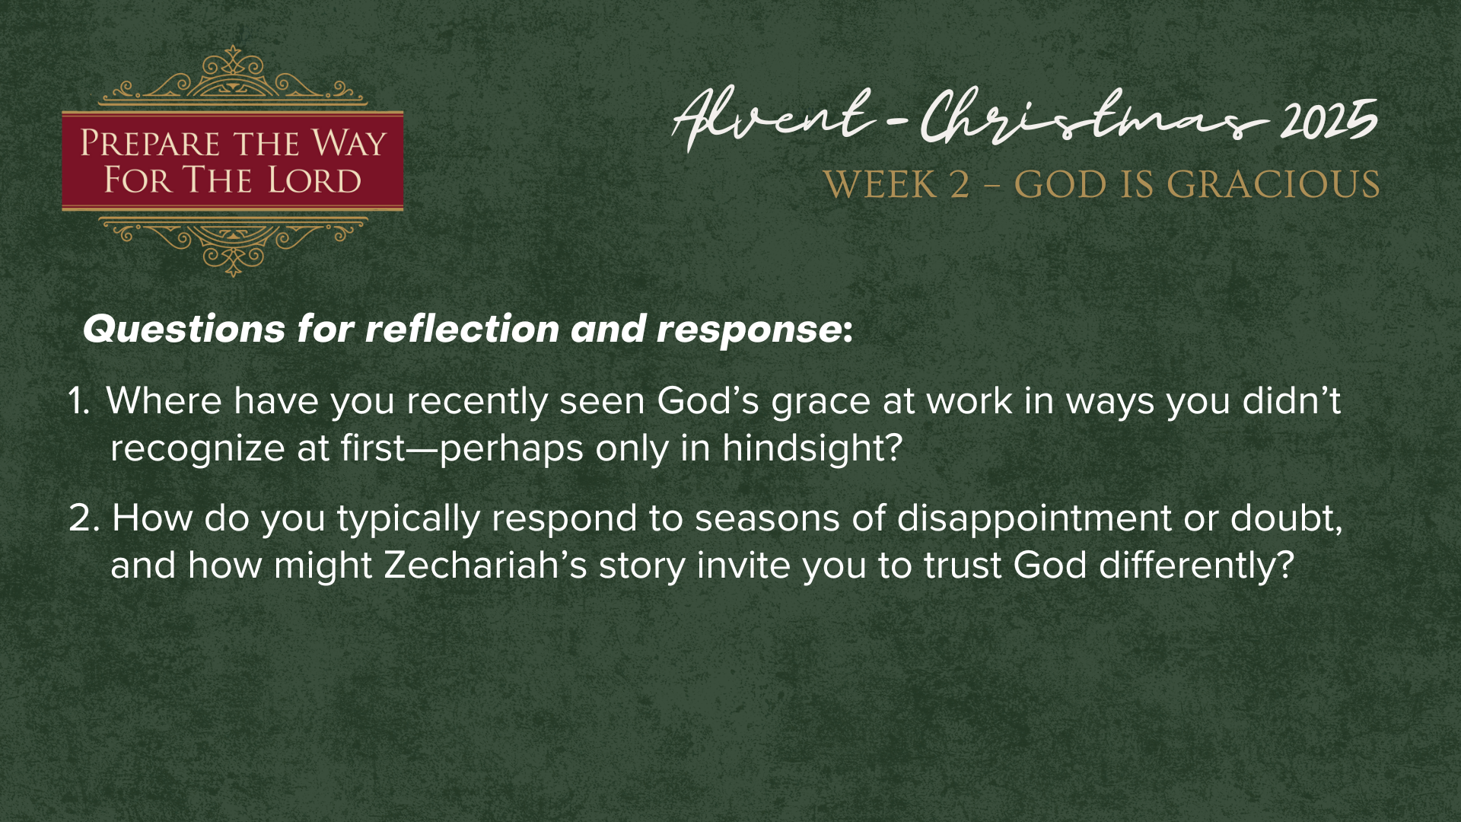

Slide 16
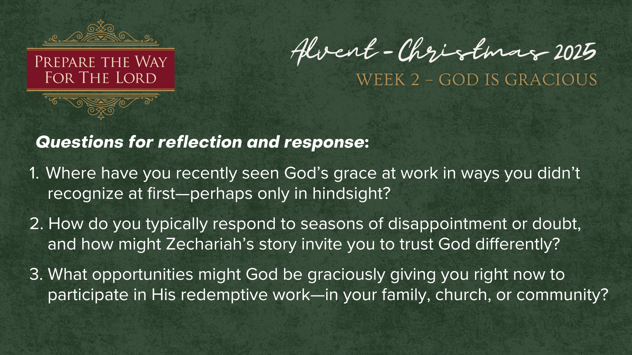
Notes:
[READ QUESTIONS & COMMENT]
Where have you recently seen God’s grace at work in ways you didn’t recognize at first—perhaps only in hindsight?
How do you typically respond to seasons of disappointment or doubt, and how might Zechariah’s story invite you to trust God differently?
What opportunities might God be graciously giving you right now to participate in His redemptive work—in your family, church, or community?
Let’s pray… [NEXT SLIDE FOR CLOSING PRAYER]

Slide 17

Notes:
[CLOSING PRAYER]
[APOSTLES’ CREED]
[COMMUNION]
Benediction
Go now as a people prepared for the Lord.
Walk in His grace, bear the fruit of His Spirit,
and shine with the light of Christ in all you do.
May the peace of God guard your hearts,
and may Christ increase in you—
today and always.
Amen.

